Slide 1
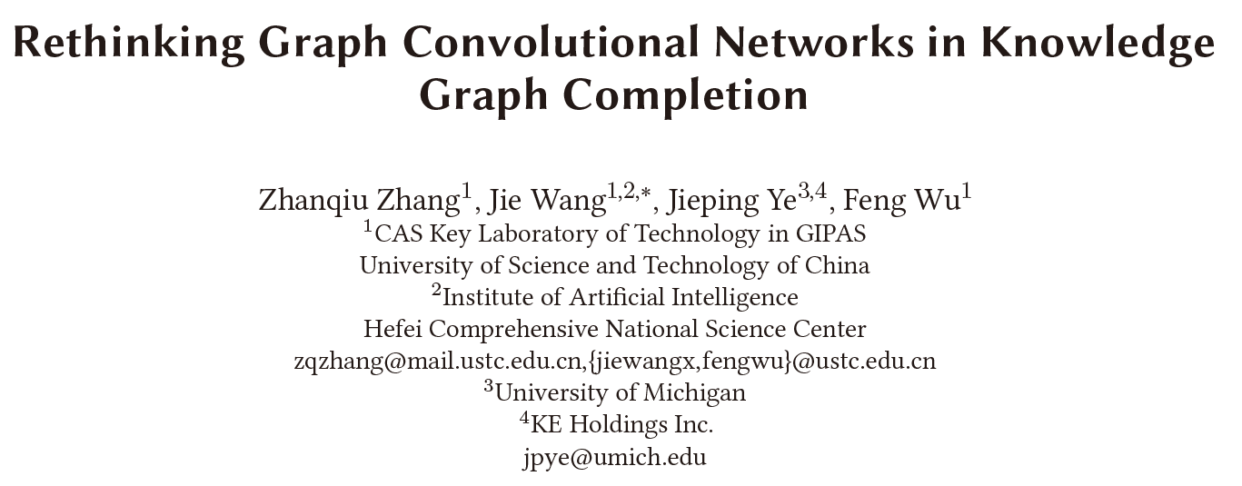
Haobo Xu
2022/10/26

Slide 2
Outlines
Background
KGC
GCN-based KGC
Rethinking
Do GCNs work in KGC?
Which factor works?
Framework & Experiments
Conclusion & Discussion
Yao, L., Mao, C., & Luo, Y. (2019). KG-BERT: BERT for knowledge graph completion. arXiv preprint arXiv:1909.03193.

Slide 3
Background
Knowledge Graph Completion
Methods
KGE
GNN for KG
PLM
…
Subtasks
Link prediction, relation prediction, triple classification

Slide 4
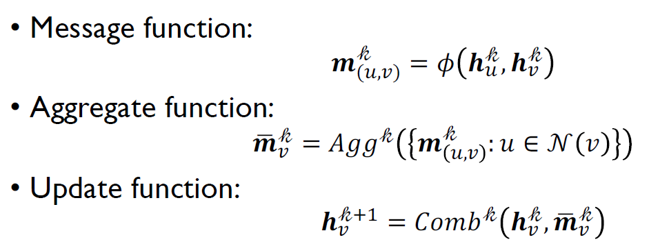
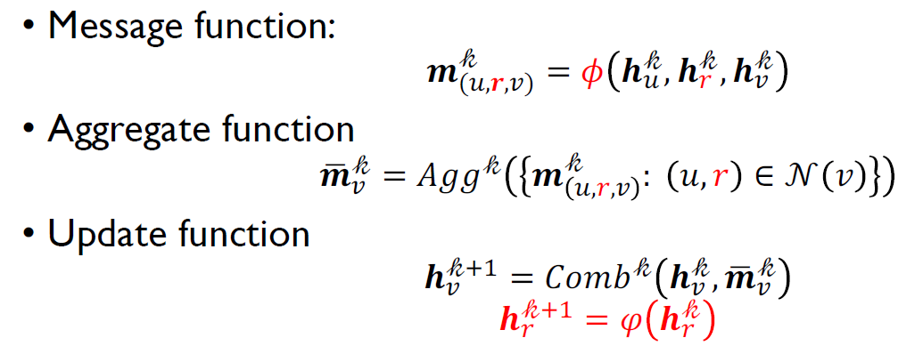
Background
Overview of GNN-based KGC
GNN message passing
GNN for KG

Slide 5
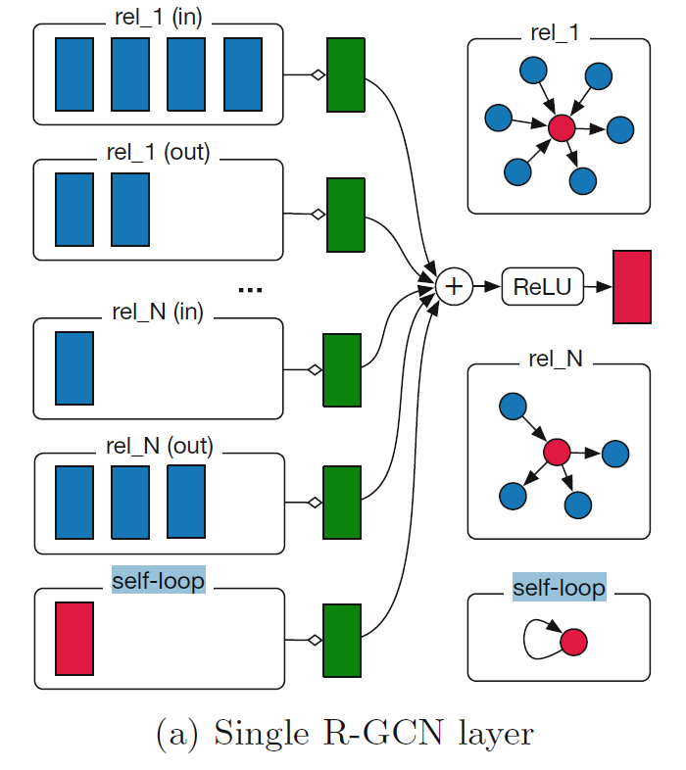

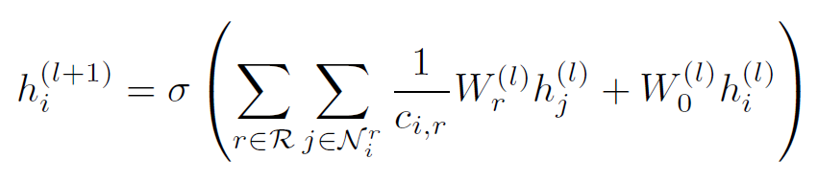
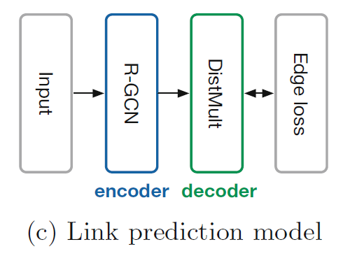
Background
RGCN
Message function
Aggregate & Update function
Including inverse edges and self loop
Subtask: link prediction
R-GCN: encoder
KGE model: decoder

Slide 6
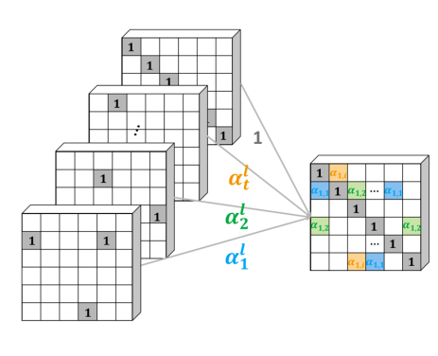

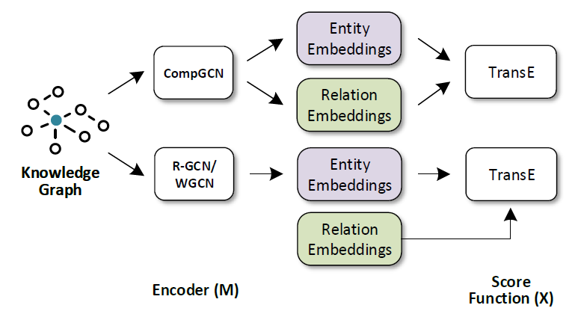
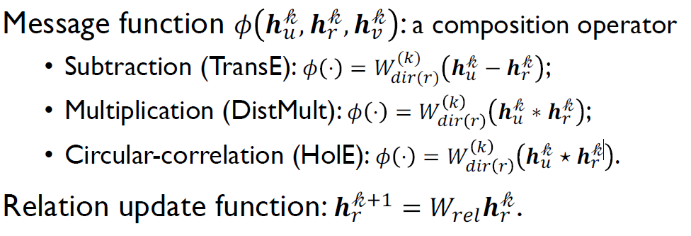
Background
WGCN
Motivation:
RGCN over-parameterization for relation representation
Methods:
Multi-relational Graph
à weighted multiple single-relational subgraphs
CompGCN
Methods:
Notes:
Rethinking之前可以overview，甚至可以先摆结论，再一步步得到这个结论，重要的放前面

Slide 7
Rethinking
Overview
Q1: Do GCNs Really Bring Performance Gain?
Conclusion: GCNs do bring performance gain.
Q2: Which Factor of GCNs is Critical in KGC?
Conclusion:
GCNs based methods have three main parts
1) graph structures -> not necessary
2) transformations for relation -> not necessary
3) aggregated entity representation -> necessary
Have the same effect.
Can substitute for each other.
Neighborhood Information
Self-loop Information
Notes:
Training strategy

Slide 8
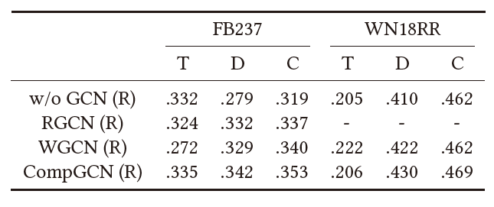
Rethinking
Q1: Do GCNs Really Bring Performance Gain?
Fact
GCNs utilize training strategies, while original KGE models not, which may be unfair
Experiment
O: original papers, R: reproduce; T: TransE, D: DistMult, C: ConvE
Conclusion: GCNs do bring performance gain.
Notes:
Training strategy

Slide 9
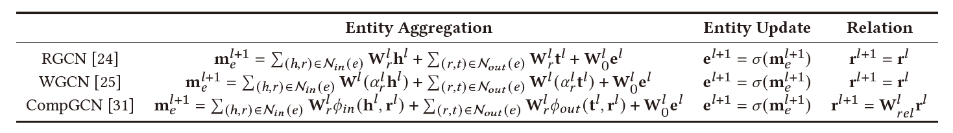
Rethinking
Q2: Which Factor of GCNs is Critical in KGC?
Consensus: Main advantage of GCNs is ability to model graph structure
Review of GCNs for KGC
Graph Structure? Self-loop Information?
Neighborhood Information? Relations Update?

Slide 10
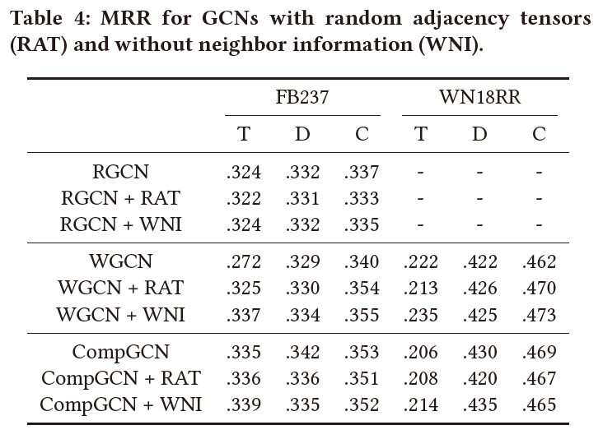
Rethinking
Graph Structure Ablation Experiment
Break graph structure
Use the random adjacency tensors in message passing
Neighbor Information Ablation Experiment
Remove neighbor information term in aggregation function
Conclusion: Neither graph structure nor neighbor information is critical.

Slide 11
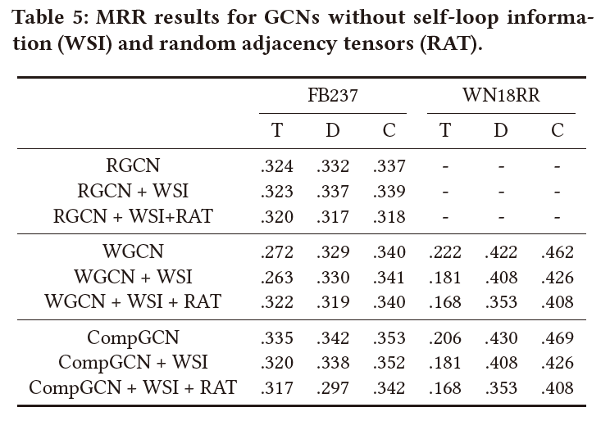
Rethinking
Self Loop Ablation Experiment
Remove self loop term in aggregation function
Result: (X+WSI) Keeping only neighbor information achieves comparative results
Self Loop + Neighbor Ablation Experiment
Result: (X+WSI+RAT) Only aggregating randomly generated neighbor information achieve comparative results
Conclusion: Neither graph structure nor neighbor information is critical.

Slide 12
Rethinking
Guesswork: The followings contain semantical information, which can distinguish entities from others
1) self-loop
The representation of each entity is independent.
2) neighbor information
Entities with different neighbors have different semantics.
3) randomly generated neighbor
Assign different neighbors for different entities with a high possibility.
Any of the above has the same effect on the final performance
Notes:
Gap 可以分成两页，在每一页rethinking底下写结论

Slide 13
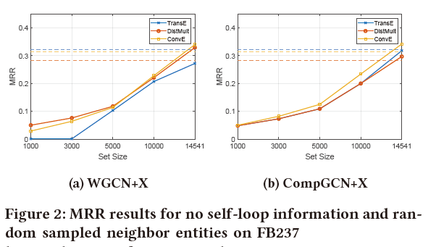
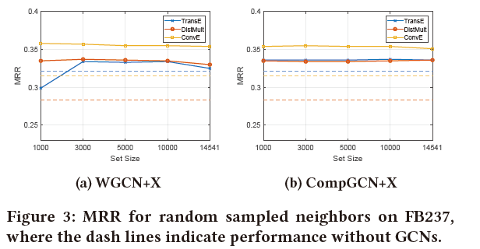
Rethinking
Experiment:
Methods: Randomly sample neighbors in a given set.
Expectation: When set size becomes smaller, entities get harder to distinguish themselves from others, thus the performance get worse
Without self-loop + Random sampled neighbors
(agree with expectation)
With self-loop + Random sampled neighbors
(disagree with expectation)
Conclusion: Self-loop / neighbor Info both can distinguish entities to bring performance gain
Notes:
Gap 可以分成两页，在每一页rethinking底下写结论

Slide 14
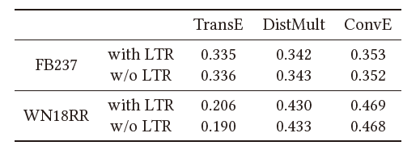

Rethinking
Linear Transformations for Relations (CompGCN)
Conclusion: Linear transformation is not necessary

Slide 15
Rethinking
Summary
GCNs based methods have three main parts
1) graph structures -> not necessary
2) transformations for relation -> not necessary
3) aggregated entity representation -> necessary
Neighborhood Information
Both of them can distinguish entity to bring performance gain
Self-loop Information
Notes:
可以作为假设放到最前面

Slide 16







Framework & Experiments
Linear Transformed Entity(LTE) – KGE Model
Framework
W_{h}, W_{t} can share the same parameters
G_{h}, g_{t} ∈ {Identity function, activation functions, batch normalization, dropout, …}
Compared to TransR
Memory-efficient and flexible to incorporate non-linear operations
Relationship with GCNs (g = Id): The gradient of loss function
LTE-TransE
LTE-DistMult
LTE-ConvE
Same as 1–Layer GCN aggregation function

Slide 17
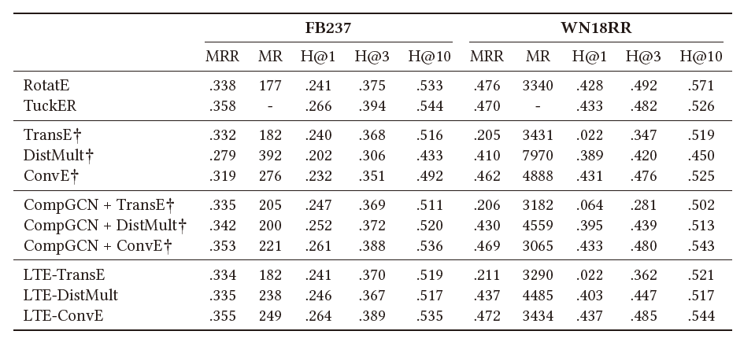
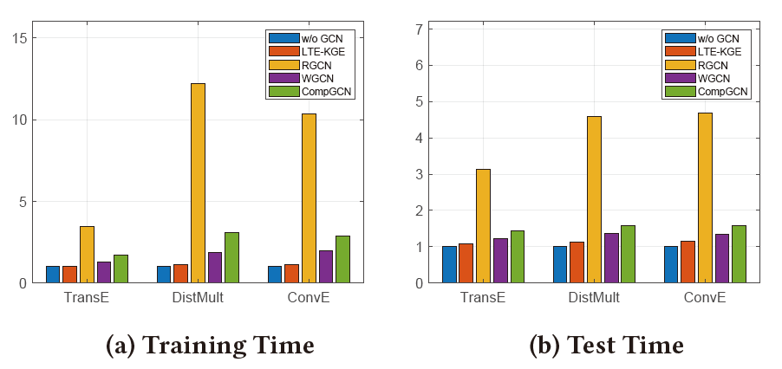
Framework & Experiments
Linear Transformed Entity(LTE) – KGE Model
Experiments
1 – Layer
GCN

Slide 18
Conclusion
The transformations for entity embeddings which can distinguish different entities account for the performance improvements for GCN-based methods.
Notes:
一个大图和100个子图，用70个训练，15个验证，得到一个random_forest，用15个预测与原图的correlation；预测完整的correlation
离散结构
离散结构+超参
RF

Slide 19
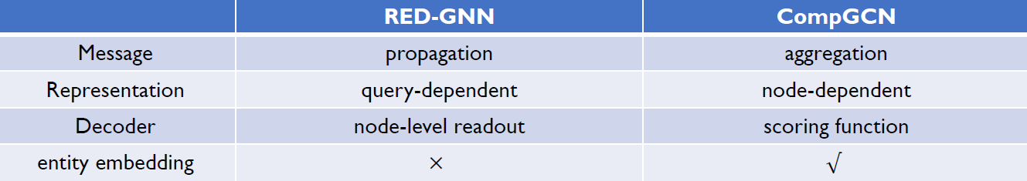
Discussion
RGCN/WGCN/CompGCN slightly outperform KGE only by transformation of entity embeddings (not by aggregating neighbor information)
RED-GNN v.s. CompGCN
This article mainly focus on aggregation-like message passing model with entity embeddings, while RED-GNN propagate message without entity embeddings.
Path (not neighbor information) seems important to bring performance gain.

Slide 20
Thanks！

